Slide 1

Project Title: Sign Language Recognition to Audio Conversion
Name | Roll No | Section
Sakshi Mishra | 2000910100153 | CSE-3
Shivam Singh | 2000910100169 | CSE-3
Udit Pratap Singh Sengar | 2000910100185 | CSE-3
Yukti | 2000910100203 | CSE-3

Slide 2
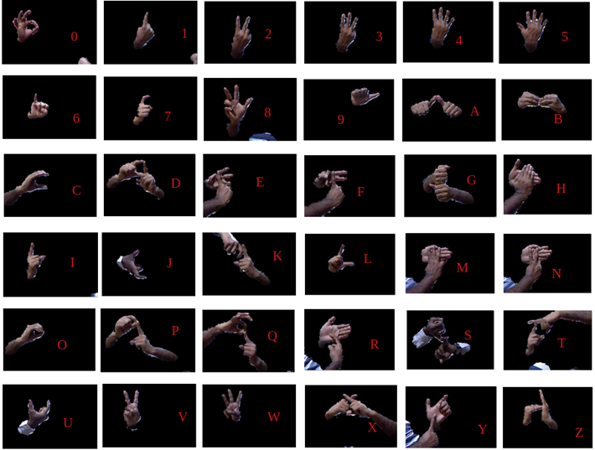
Introduction
From sign language audio
Overview
Idea behind the project
Innovations
Feasibility

Slide 3
OBJECTIVES
The objective of our project is :
Ease the communication between normal people and differently abled people.
Eliminate the need of attending costly Sign Language classes.
Eliminate the need of Translator.
To reach more audience during speeches and
campaigns.

Slide 4
HARDWARE & SOFTWARE REQUIREMENTS
Hardware | Software
GPU: RTX 3050: Features: 1.55- 1.7GHz 64 tensor core | Google Colab Pytorch & torchvision Resnet9 architecture Relu function
Camera : Focal L. 3.74mm , Exposure time 1/17s | Open CV, pyttsx3

Slide 5
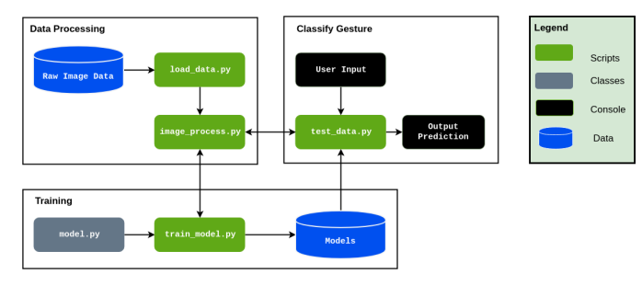
PROPOSED IDEA OF PROJECT
The learning aids for hearing and speech-disabled people exist but the usage of these aids are limited.
The proposed system would be a real-time system where in live sign gestures would be processed using image processing.
Then classifiers would be used to differentiate various signs and recognize the alphanumeric gestures which will further be converted into text and audio.

Slide 6
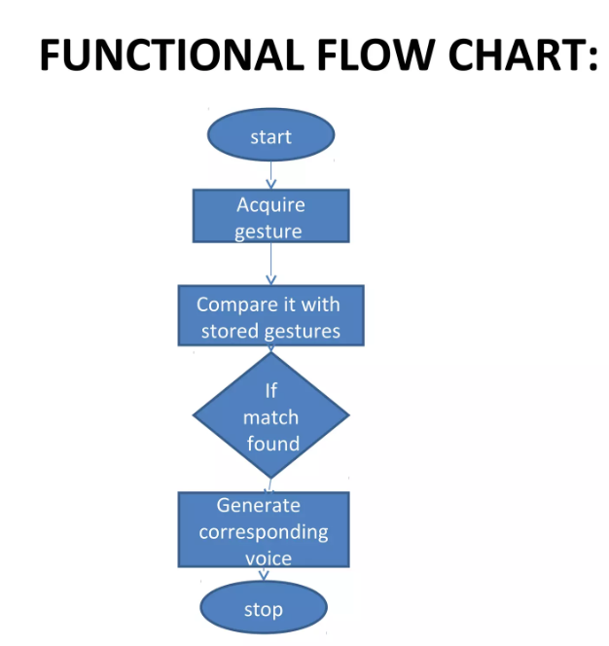

Slide 7
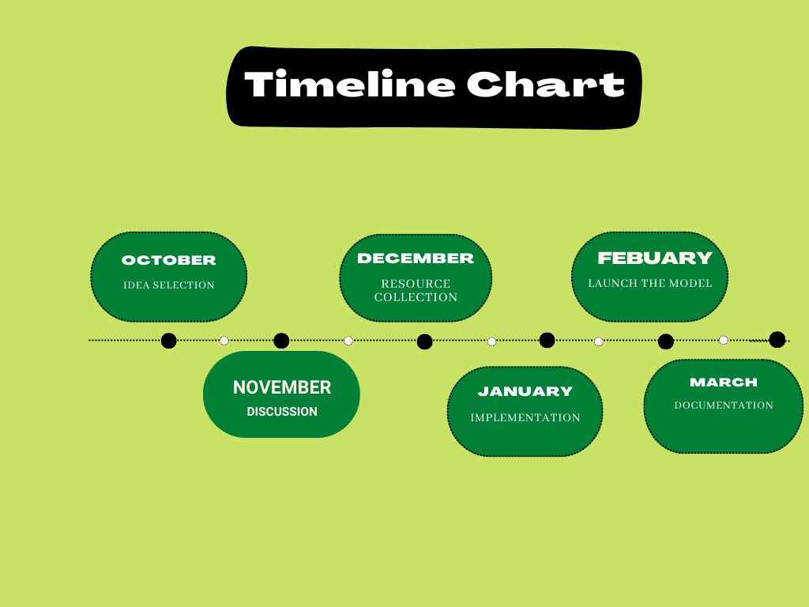

Slide 8
PROJECTED OUTCOME
Research Paper
Improve Accuracy
Include improvised idea
Use of pyttsx3

Slide 9
REFERENCES
Kaggle.com – https://www.kaggle.com
Real-time Indian Sign language recognition Report – NIT Trichy
Research Paper- MIE324 Report Sign Language Recognition (Anna Deza and Danial Hasan)
Data Flair Training Blog
Torchvision – https://pytorch.org/vision/stable/index.html

Slide 10
THANK YOU

